Slide 1
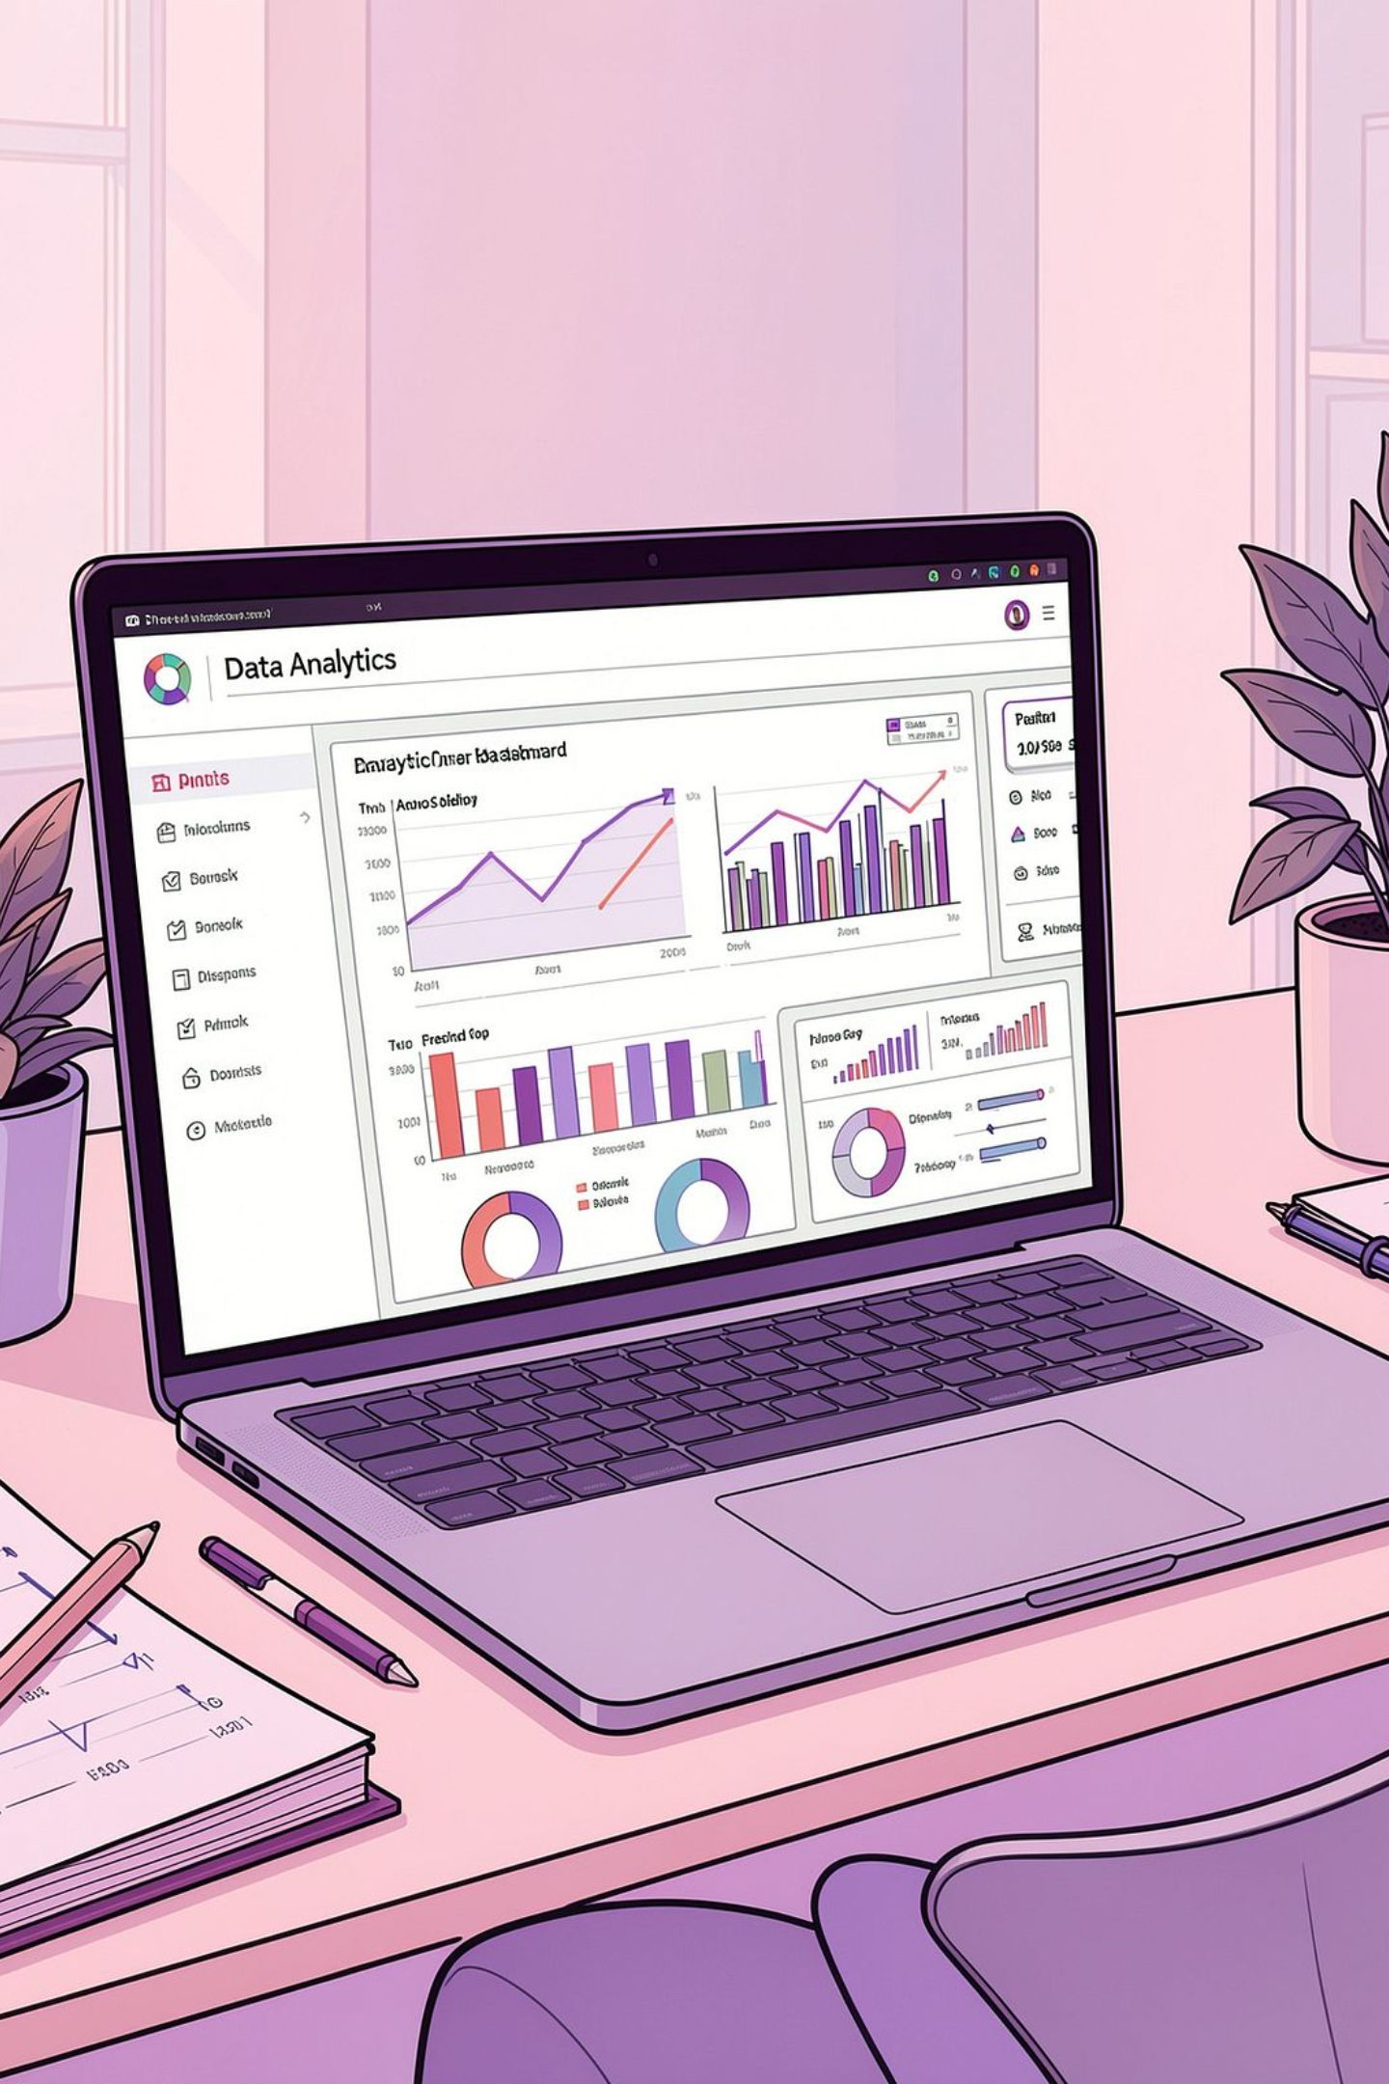
Customer Behavior Analysis
An end-to-end data analytics project exploring purchasing patterns, demographics, and spending behavior using Python, Pandas, and SQL.
DATA ANALYTICS
PYTHON · PANDAS · SQL

Slide 2





Project Objectives
Purchasing Behavior
Demographics
Product Preferences
Understand how customers shop
Identify key customer segments
Analyze category and item choices
Spending Patterns
Business Insights
Study amounts, discounts, frequency
Generate actionable findings via EDA & SQL

Slide 3
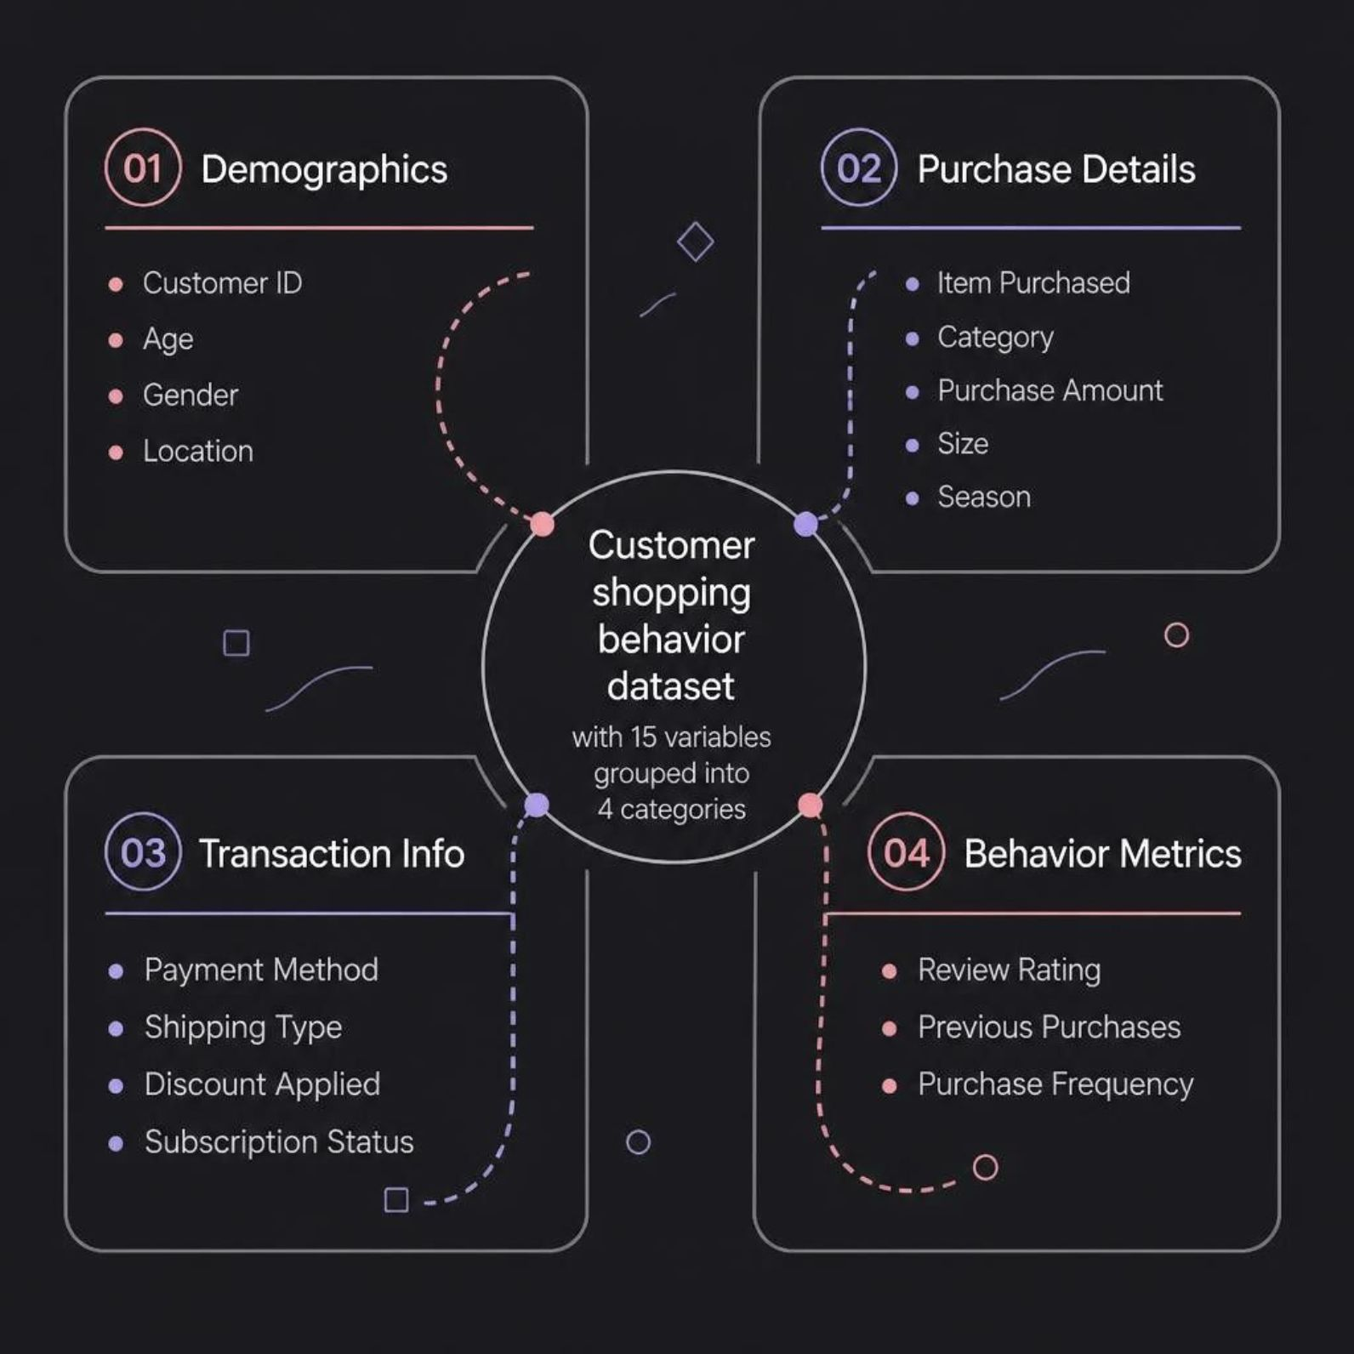
Dataset Overview
15 Variables
Spanning demographics, transactions, and behavioral metrics
Customer ID, Age, Gender, Location
Item Purchased, Category, Purchase Amount
Subscription Status, Payment Method
Discount Applied, Previous Purchases
Purchase Frequency, Review Rating

Slide 4




Tools & Technologies
Python
Pandas
Core language for data analysis
Data cleaning and manipulation
Jupyter Notebook
MySQL / SQL
Analysis and documentation
Querying and extracting insights

Slide 5
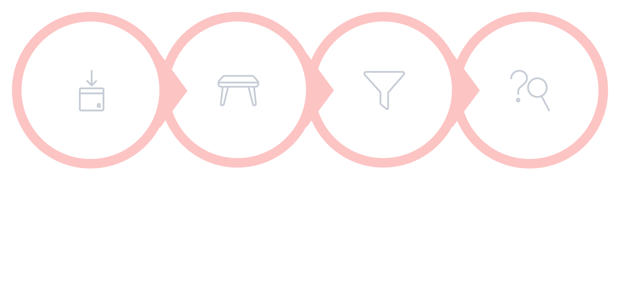
Data Cleaning & Preparation
Load & Inspect
Handle Missing
Prepare for SQL
Check Types
A structured cleaning pipeline ensures data quality before exploratory and SQL-based analysis.

Slide 6

Exploratory Data Analysis
Demographics
Categories & Products
Purchase Amounts
Age, gender, and location patterns
Most purchased items and categories
Spending by segment and subscription
Discounts & Payments
Frequency
Usage rates and method distribution
Previous purchases and repeat behavior

Slide 7
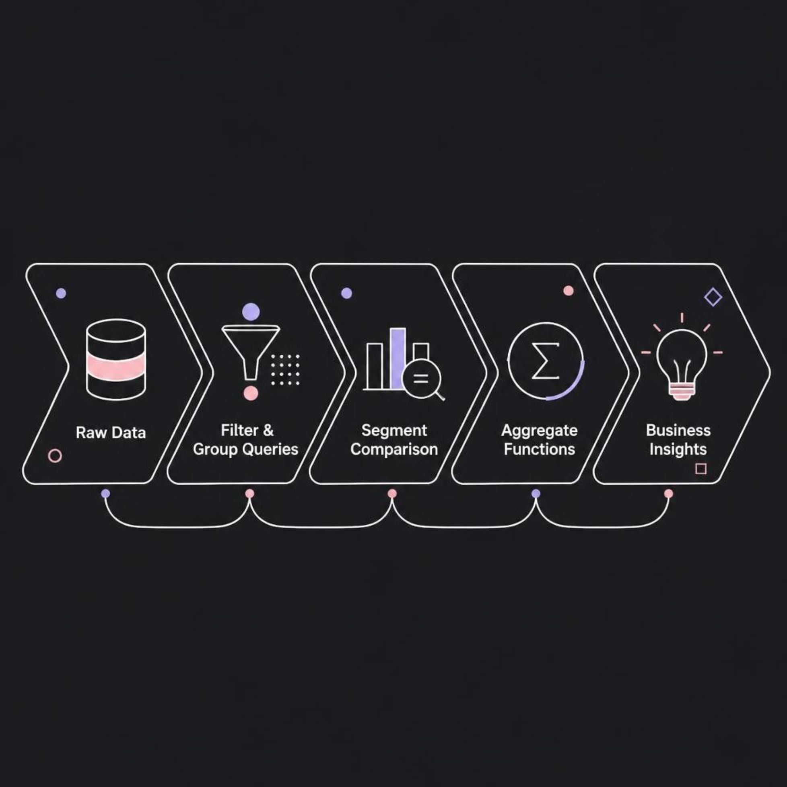
SQL Analysis
Query Techniques
Filter, group, and summarize data
Compare behavior across segments
Analyze categories and spending patterns
Use aggregate functions for insights

Slide 8
Suggested Visualizations
Key charts to communicate findings
1
Gender Distribution
2
Age Group Breakdown
3
Purchase Amount by Category
4
Top Categories & Items
5
Subscription vs. Spend
6
Discount Usage
7
Payment Methods
8
Purchase Frequency

Slide 9
Business Value
Customer Segments
Product Preferences
Better understanding of who buys what
Insights into category and item demand
Spending Behavior
Data-Driven Decisions
Patterns in amounts, discounts, frequency
Raw data transformed into actionable info

Slide 10


Conclusion
Understand Data
Clean & Prepare
Explore Patterns
Query with SQL
Customer Behavior Analysis demonstrates a complete data analytics pipeline — from raw data to actionable business insights.
This project combines data cleaning, EDA, and SQL to study customer shopping patterns and support data-driven decisions.

